Slide 1
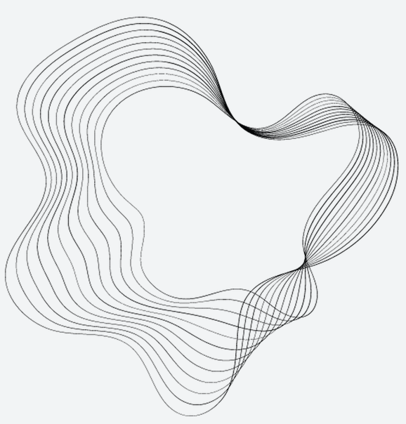
Digital Technology
Brandon Weathers

Slide 2
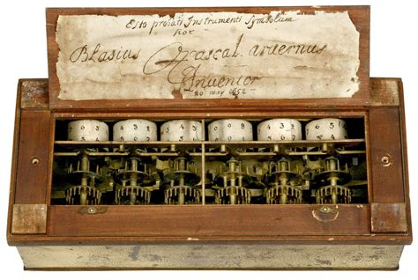
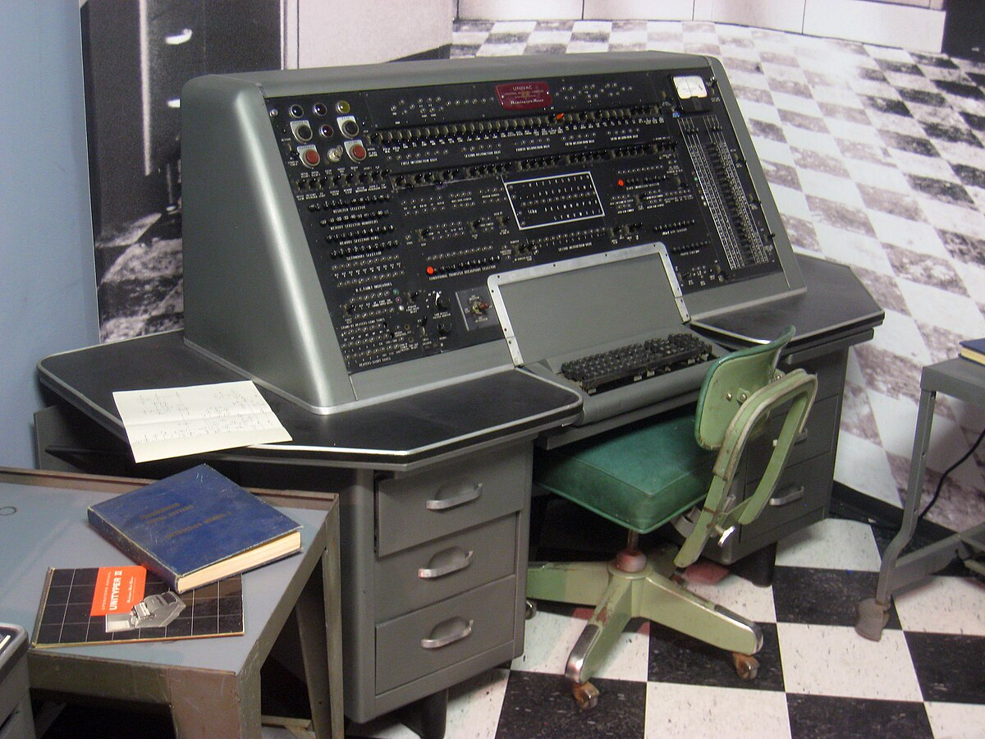
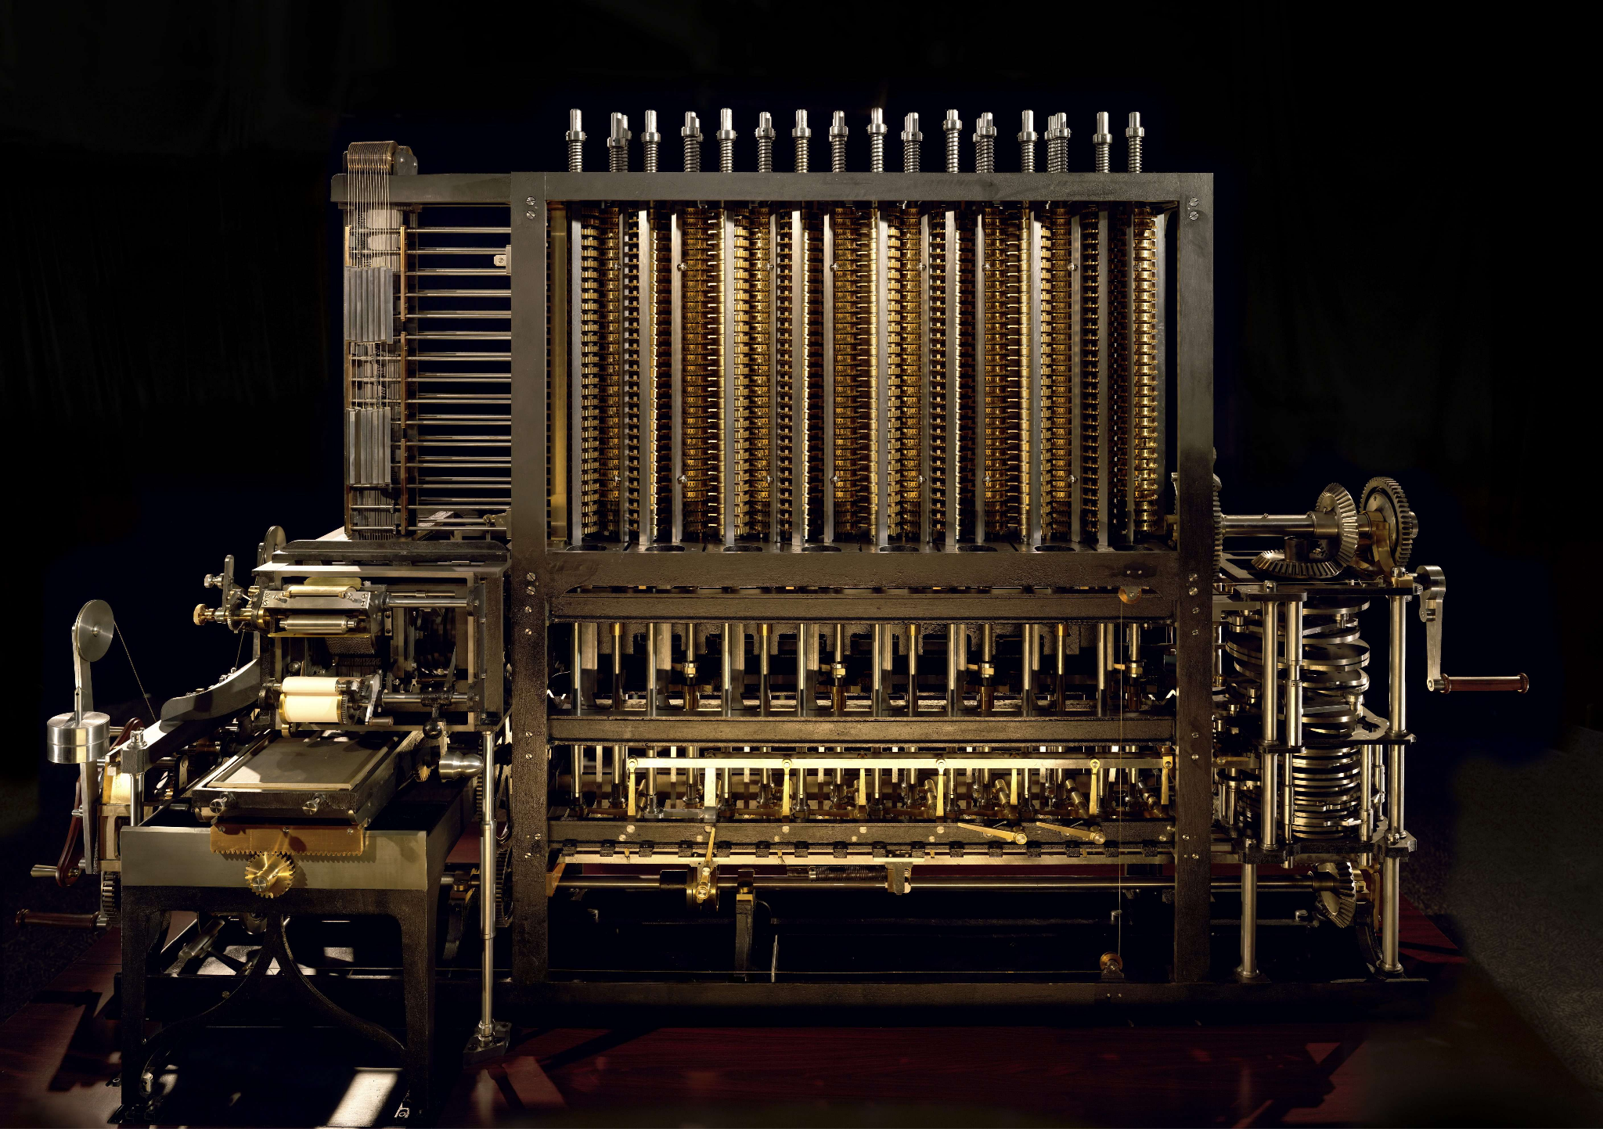
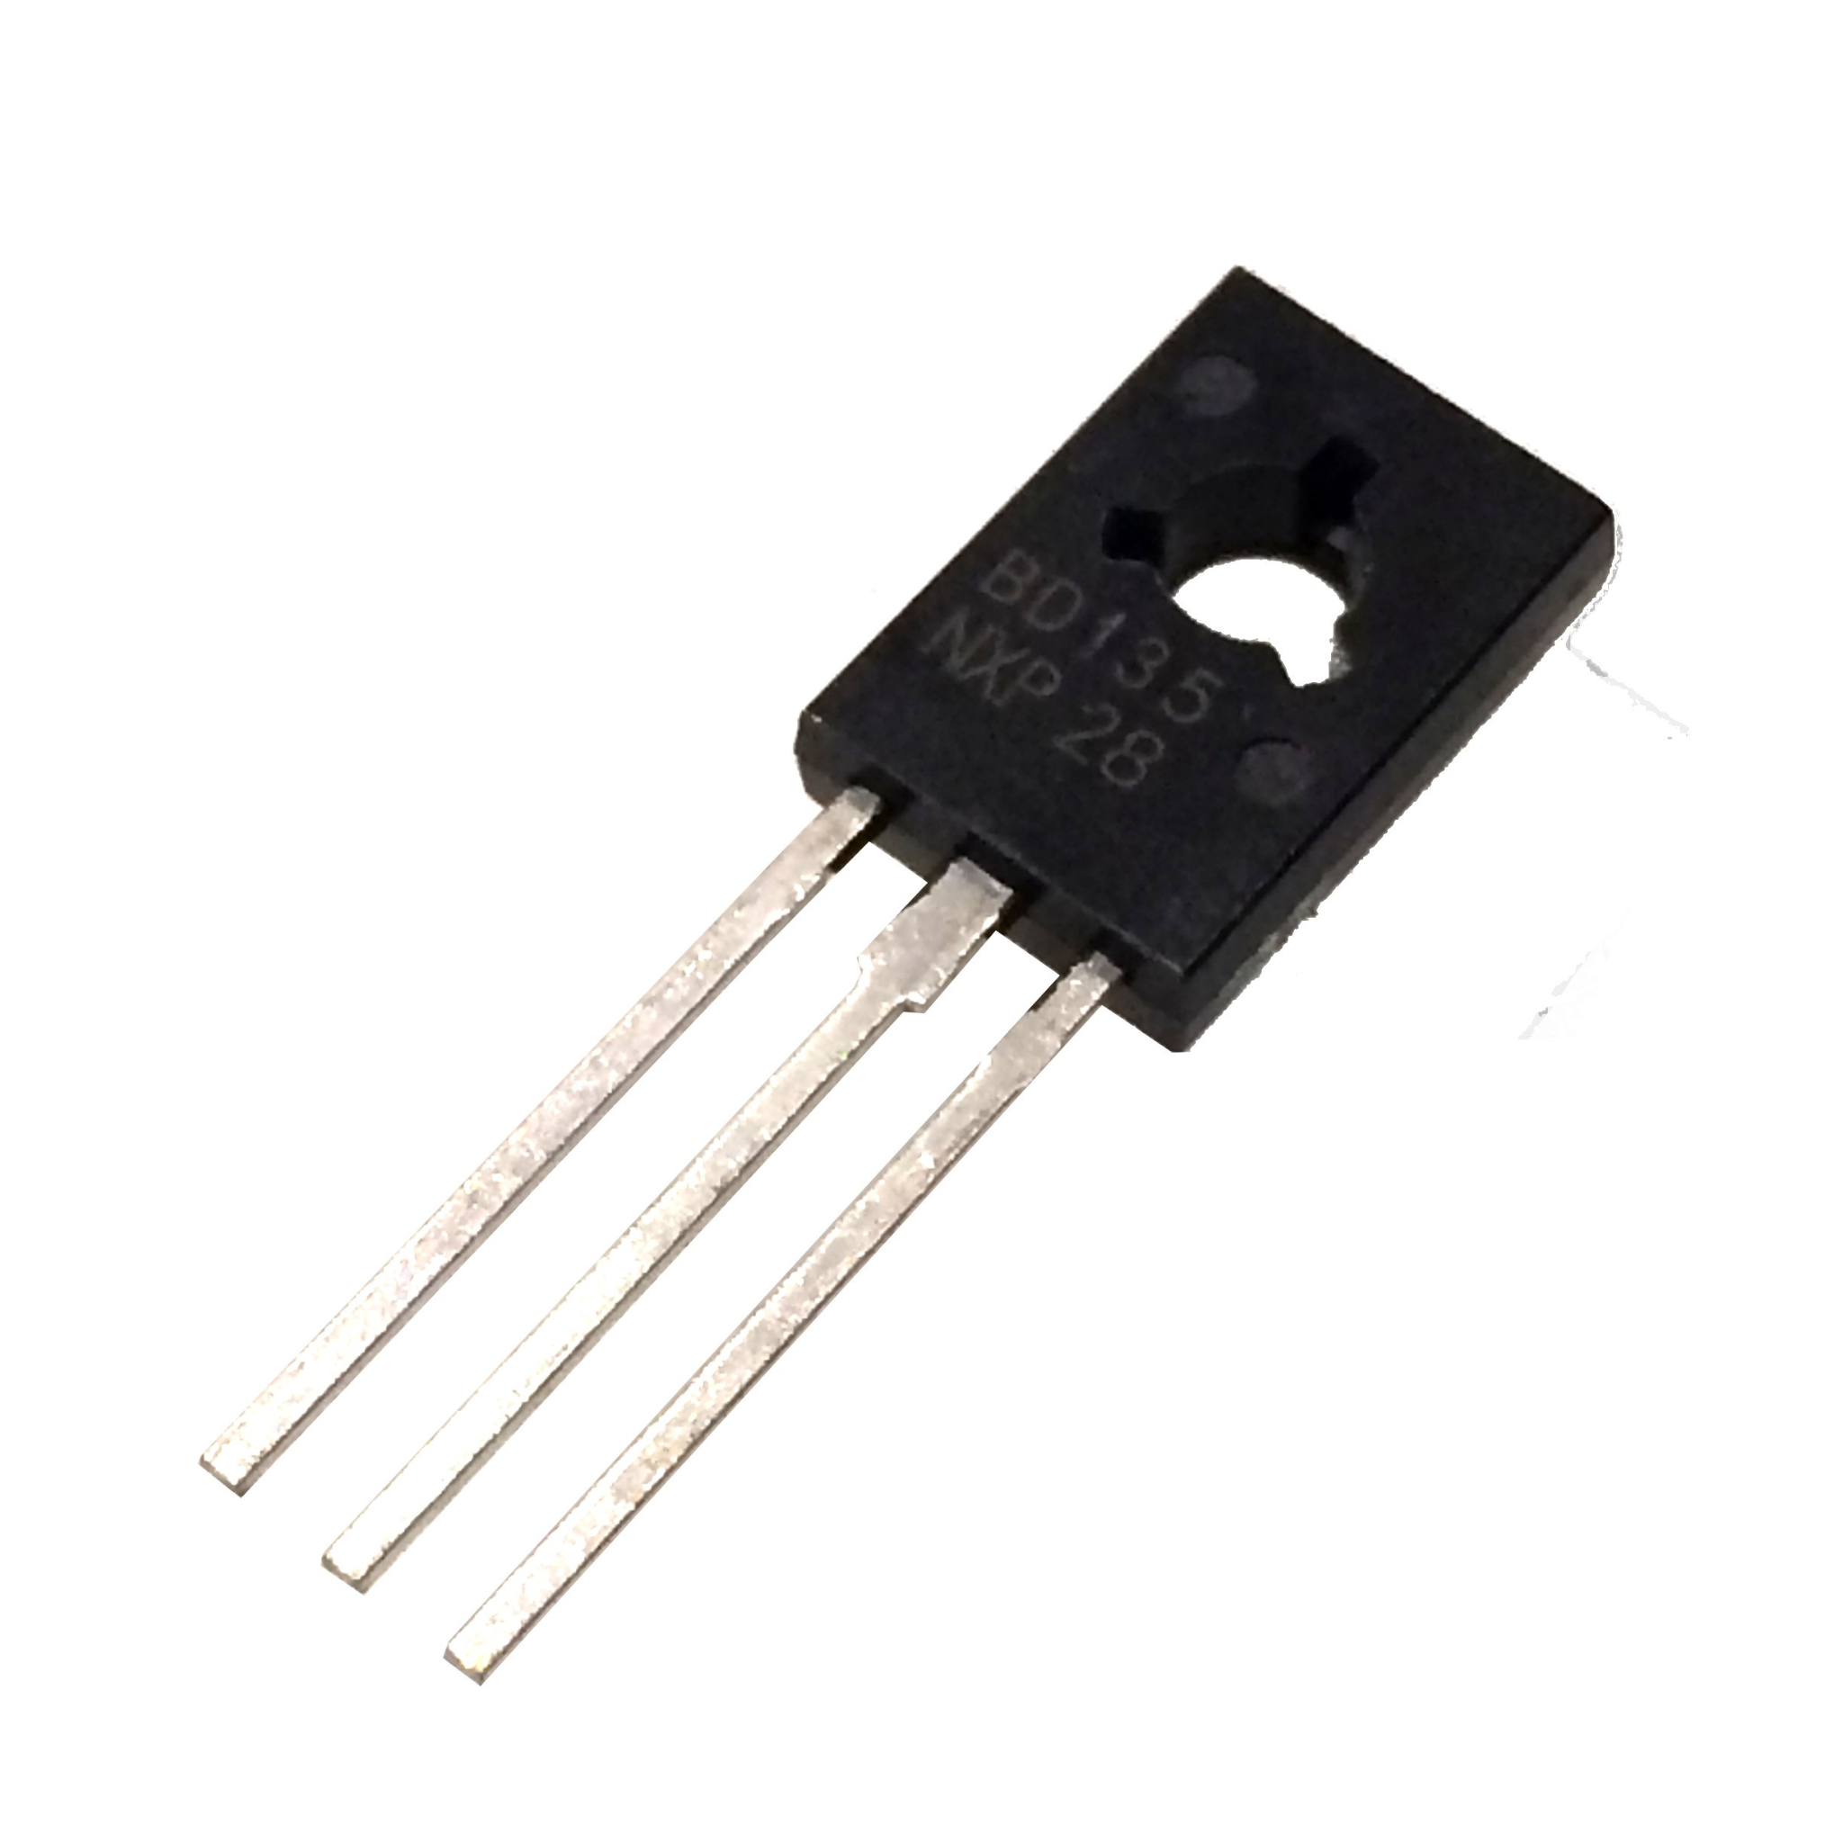
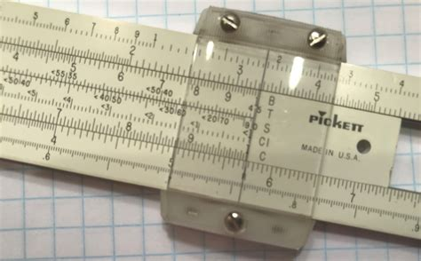
A Brief History of Digital Technology_{(2a)}
1642: Mechanical Calculator (Pascaline)
It mechanically aids in arithmetical computation.
1940s: ENIAC and UNIVAC
The first programmable general-purpose electronic digital computer.
1620: Slide Rule
At that time it was used only to calculate logarithms.
1820s: Difference Engine
It was the first mechanical computer.
1947: Transistor

Slide 3
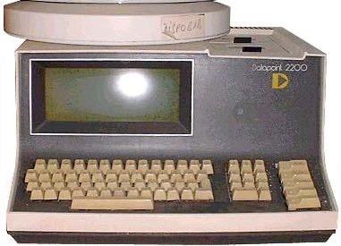
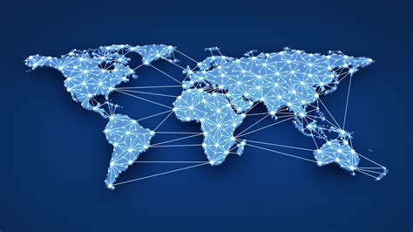
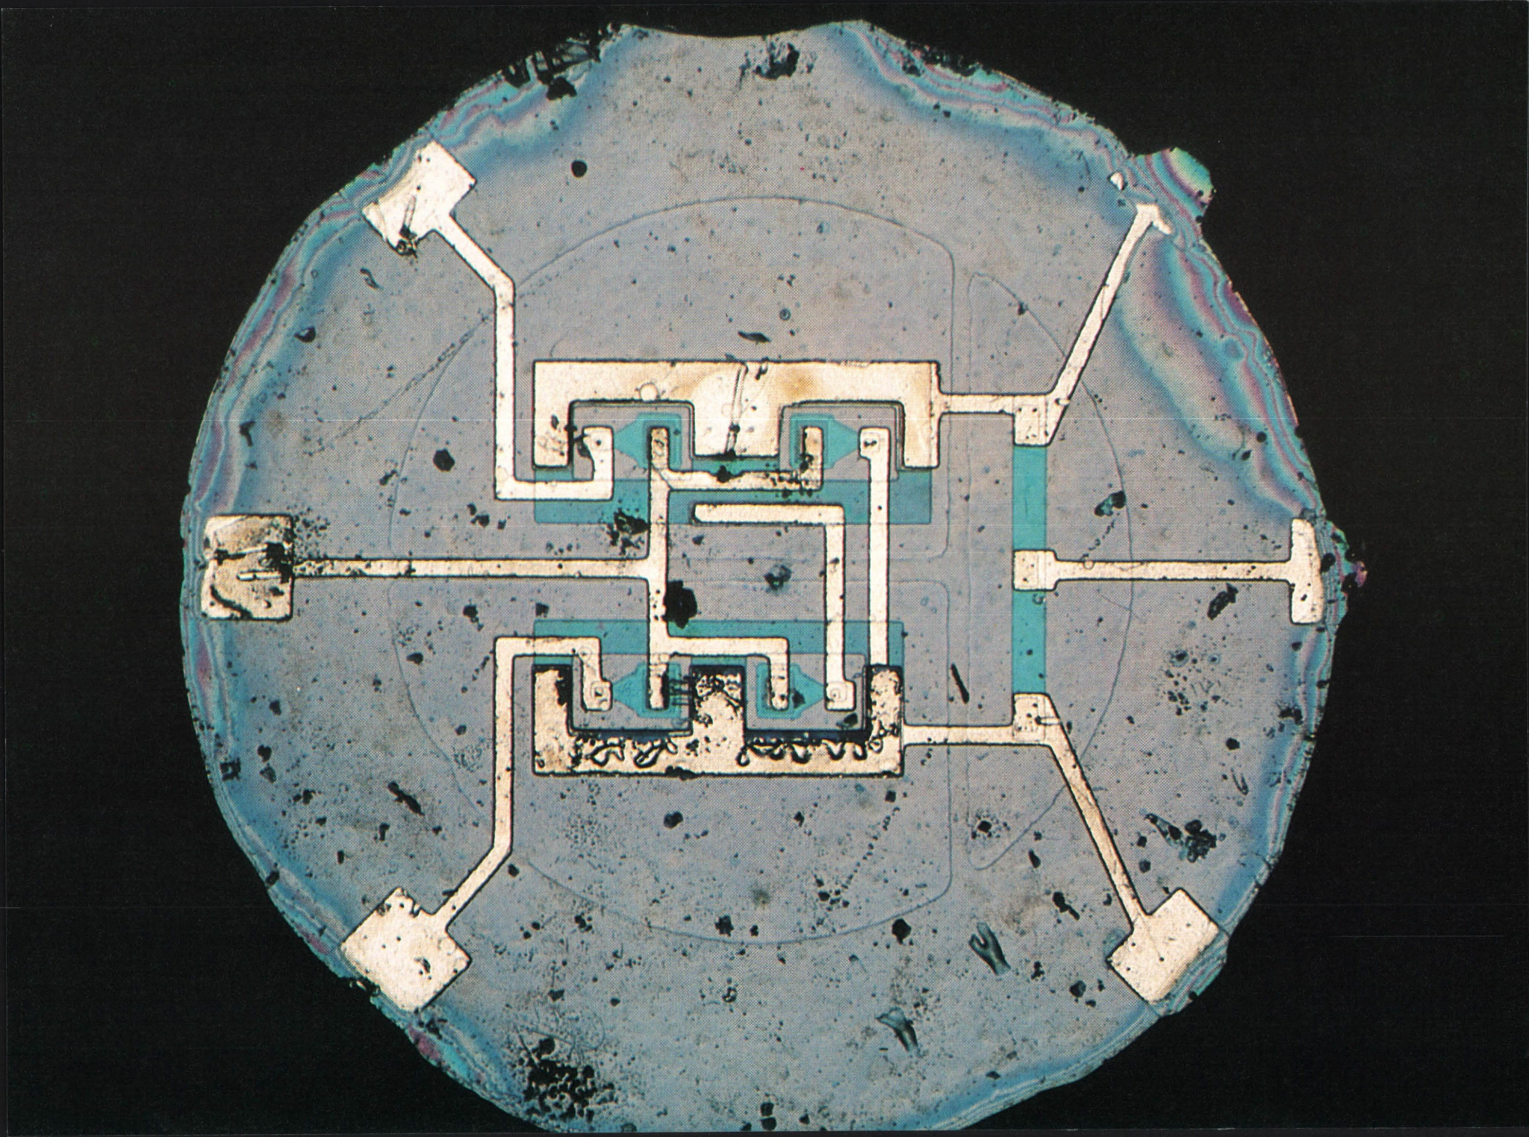
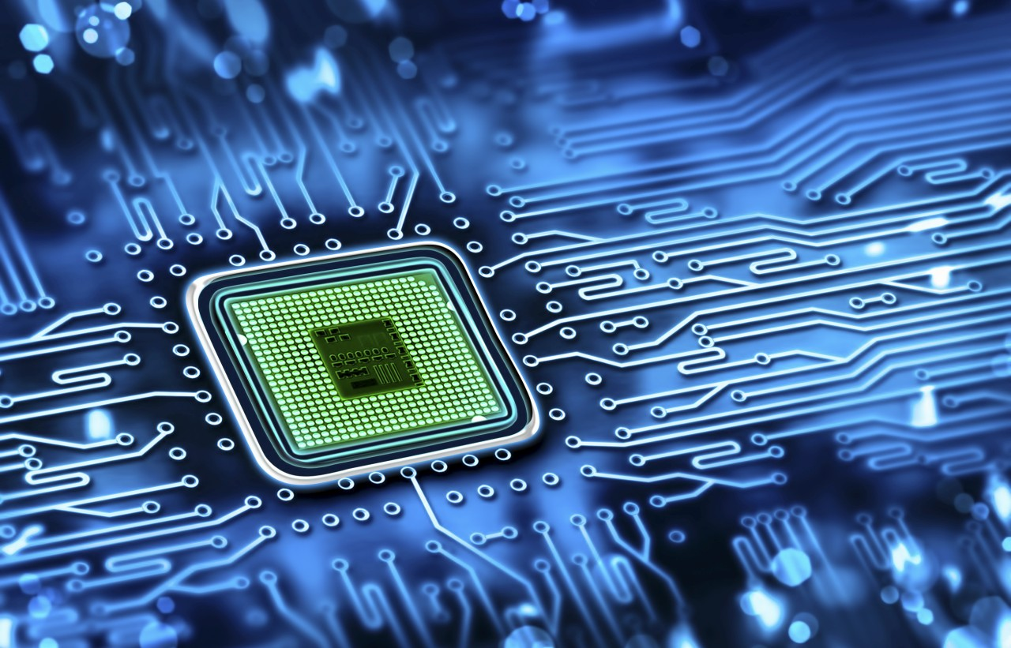
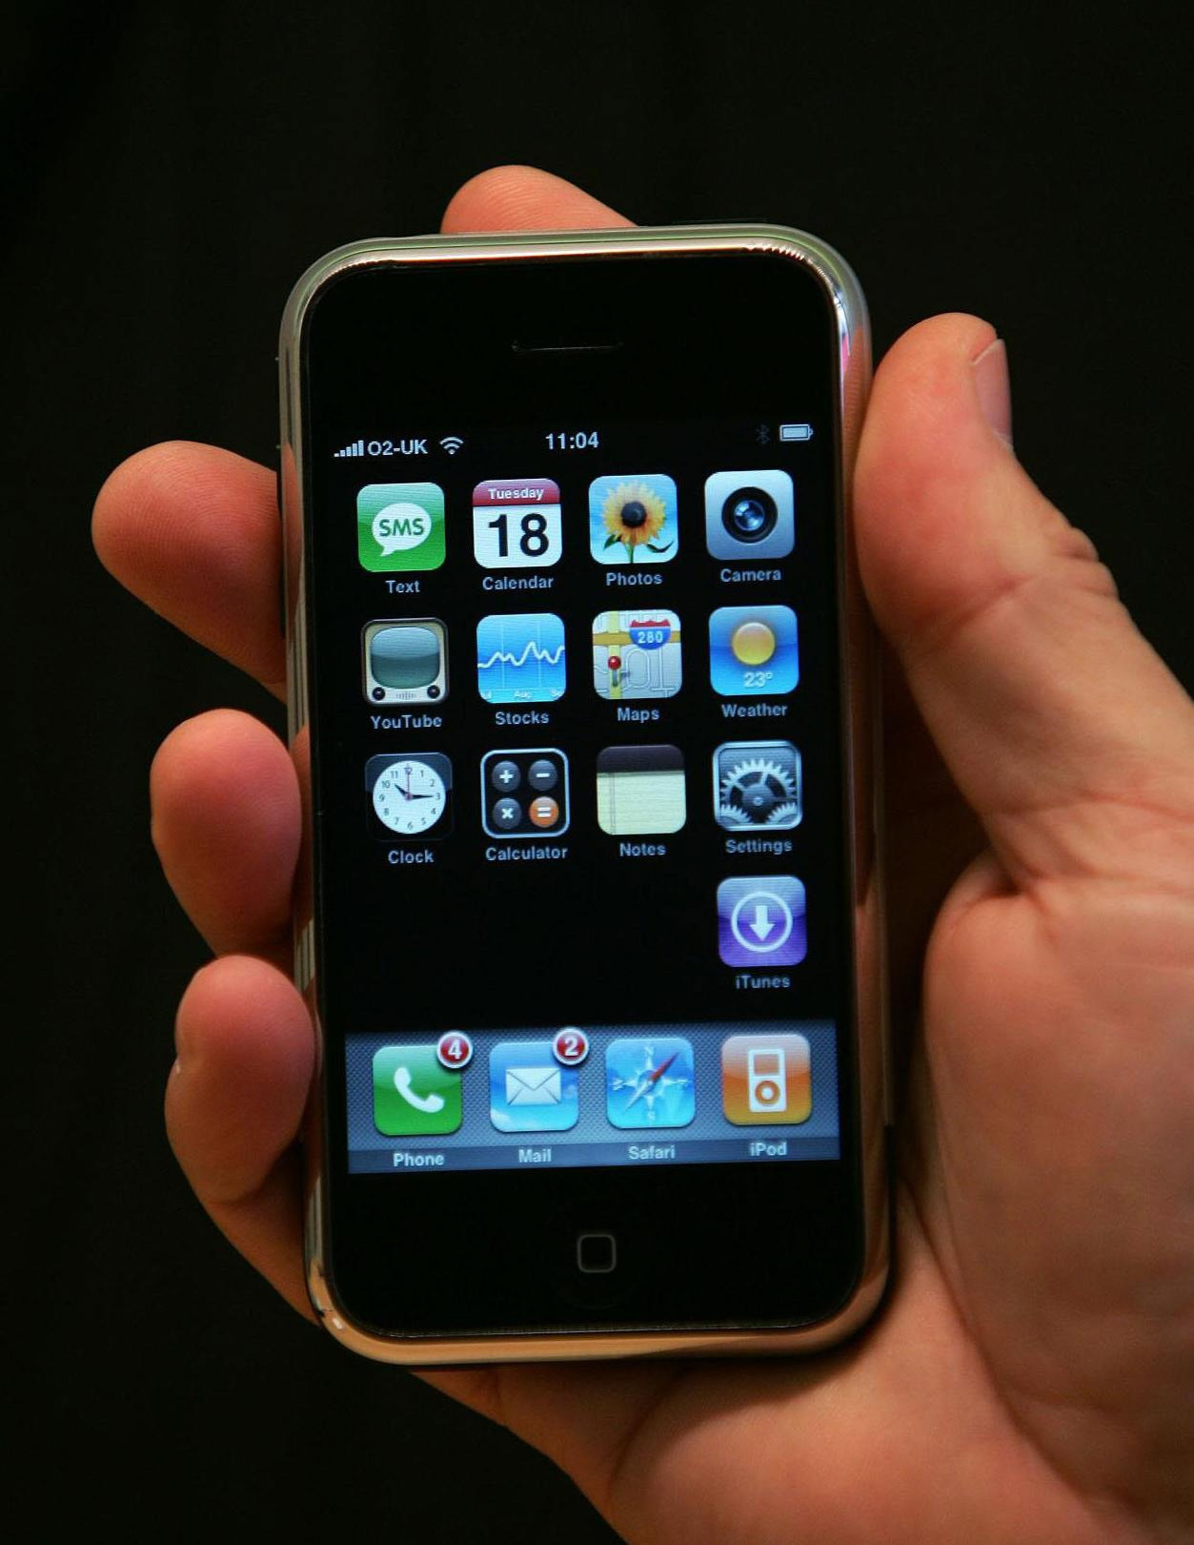
A Brief History of Digital Technology_{(2a)}
1970s: Personal Computers
1990s: World Wide Web
1950s: Integrated Circuit (chip)
1971: Microprocessor
2000s: Handheld devices

Slide 4
What Will the Future of Digital Technology Look Like?_{(2b)}
General artificial intelligence
Adoption of self driving cars
Immersive virtual reality
Healthcare advancements
Quantum computing advancements

Slide 5
How Computers Communicate
Humans understand many things.
Language
Images
Audio
Touch / tactile sensations
Computers understand only two thing.
There IS electricity flowing through me (represented with a 1)
There IS NOT electricity flowing through me (represented with a 0)
How can one communicate to another through a computer that does not understand them?

Slide 6
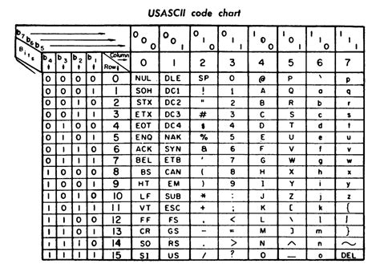
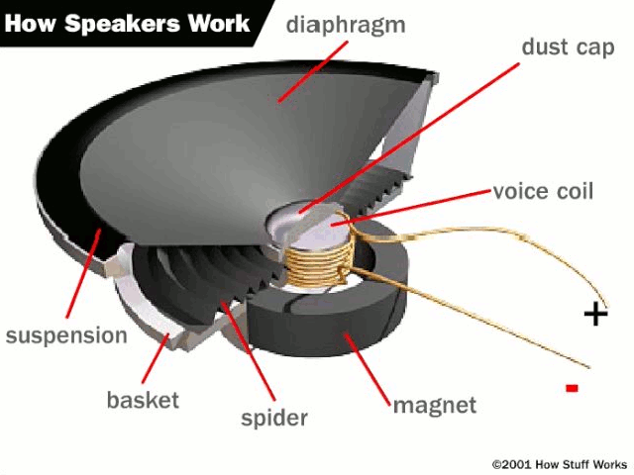
The Translation of Information_{(3a)}
Computers store info based on its type.
The ASCII table translates characters into 1s and 0s.
Images can be stored by looking each pixel (the fundamental component of an image) and translating its color into an rgb value.
Sound is the vibration of air which can be represented as a wave. An electromagnet is a device that can acquire a magnetic field on command. We can use this, along with a mathematical representation of a sound wave, to vibrate air accordingly.

Slide 7
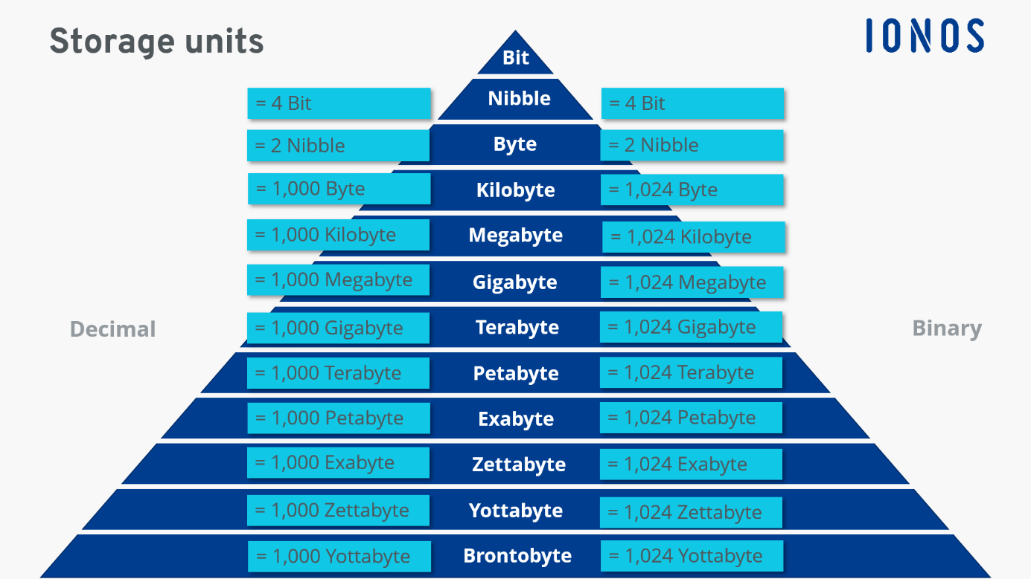
The Storage of Information_{(3a)}

Slide 8
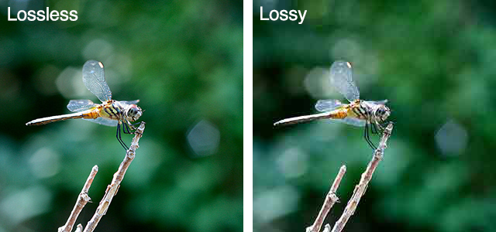
Data Compression_{(3b)}
To reduce the size of a file, removal of info is commonly practiced.
If you remove data that can be later replaced, it is called lossless compression. (Often used when transporting computer programs.)
If you remove data that cannot be later replaced, it is called lossy compression. (Often used when transporting audio or pictures.)

Slide 9
Digital Devices Before and After Programming_{(3c)}
Most people today use digital devices.
Two of the most common are the smartphone and the personal computer.
What can a smartphone or personal computer do without its programming?
What can a smartphone or personal computer do with its programming?

Slide 10
Without Programming | With Programming
Paperweight? | Access the internet Word processing Play video games Check email Watch videos Store information Listen to music

Slide 11
Computers
Desktop
Server rack
TV
Home security system
Supercomputers
Nintendo Switch
DS
Game boy and variants
Playstation Portable
Mobile Devices
Phone
Flash drive
Some car parts
Headphones
Laptops
Credit card
Consoles
Xbox
Playstation
Wii
NES

Slide 12
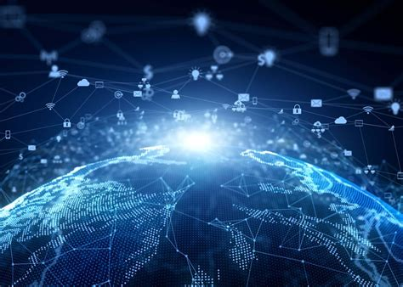
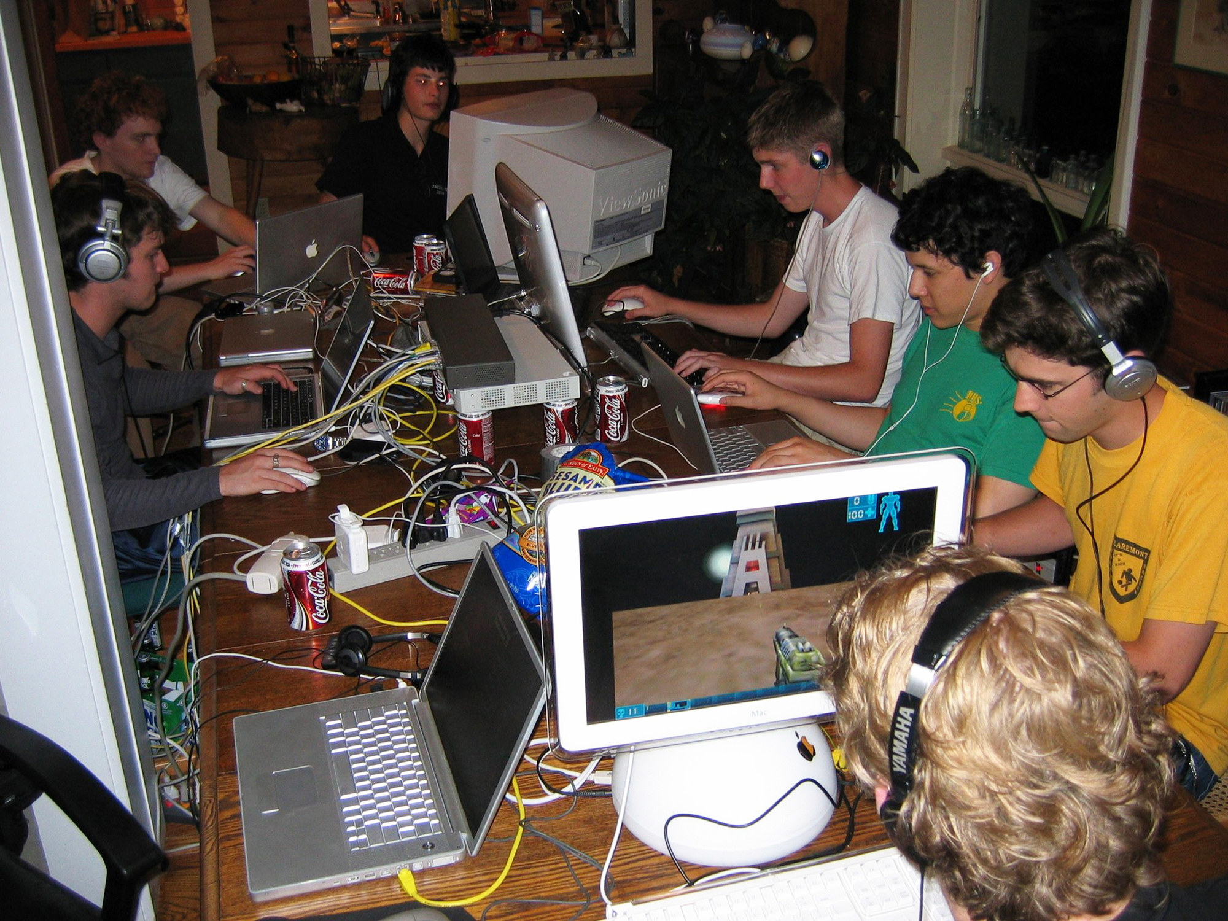
LAN vs WAN_{(3d)}
There are two ways a computer can connect to other devices, through a:
Local Area Network (LAN)
Wide Area Network (WAN)
As the name suggests, the only difference between a Local and Wide Area Networks is the area they cover.
For example the internet or a business-wide network is an example of a WAN, while a household network, or gaming get-together (LAN party) is an example of a LAN.

Slide 13
Software Applications_{(4a, 4b, & 4c)}
A software application, or “app”, is a set of instructions in a programming language that when executed will help people perform an activity.
Commonly used apps:
Web browser (Google Chrome, Microsoft Edge, or Firefox)
File manager (File Explorer and Finder)
Gaming Clients (Steam, Battle.net, or EA game launcher)
Operating system (Windows, MacOS, iOS, or Android)
Unfortunately, not all software is good. In fact, some programs intend to cause disruption and are therefore malicious software, or malware.

Slide 14
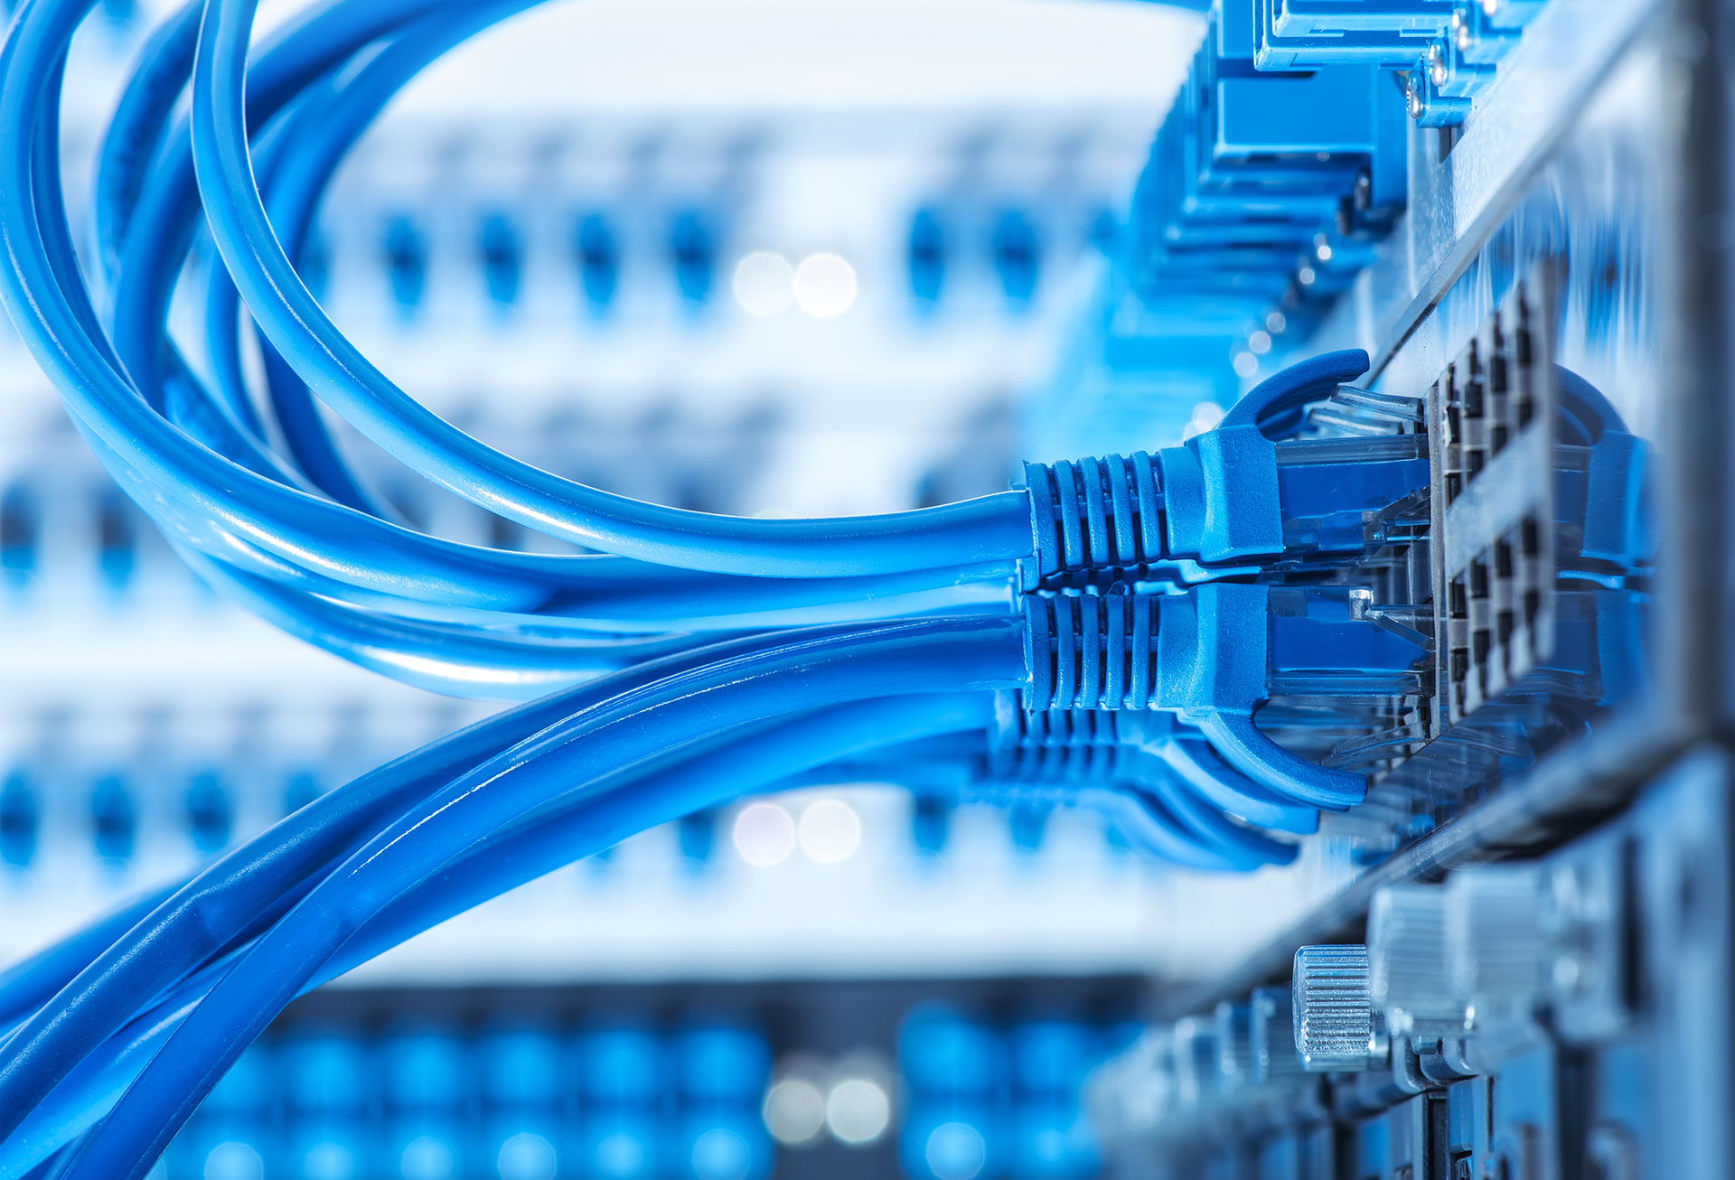

Transferring Data Through the Internet_{(5a)}
Many tasks performed on a computer rely on the use of information sourced from distant locations.
Main methods used:
Wired connections (ethernet and fiber optic cables)
Wireless connections (Wi-Fi and cellular data)

Slide 15
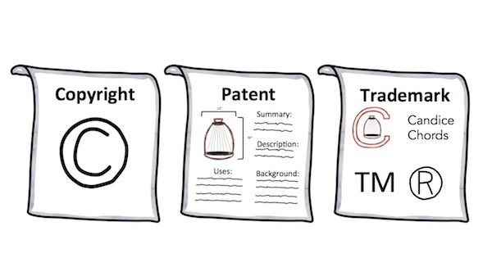

Proprietary Information_{(7a & 7b)}
Copyright - protects the expression of an idea (books and films)
Patent - protects inventions (GPS and 3D printer)
Trademarks - protects symbols
Trade Secret - protects information that has value and is withheld
Public Domain - not protected

Slide 16
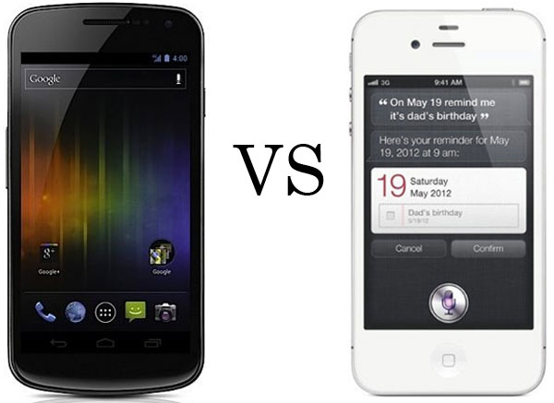
Intellectual Property Dispute_{(7c)}
Apple v. Samsung (2011)
On 1/4/2007, Apple applied for 4 design patents right before the iPhone was announced. In 2010 these patients were used as evidence that Samsung marketed a phone was too similar to Apple’s.
In particular, Apple claimed that the Nexus S, Epic 4G, Samsung Galaxy Tab, infringed on Apple’s intellectual property.
This basic idea was seen in multiple lawsuits from Apple to Samsung but eventually ended with in 2018 when both companies decided to back down from their claims because the awarded compensation would not be worthwhile.

Slide 17
Recycling Hardware_{(8a & 8b)}
Digital devices may contain lead, mercury, arsenic, bromine, cadmium, chlorine, and acids, all of which hurt the environment if not properly disposed of.
To become a certified recycler of digital technology hardware devices, the US Environmental Protection Agency (EPA) inforces different rules for different types of recyclers.
For business, government, and large purchases, the EPA requires that the organization in question must have either an e-Stewards or R2 certification.
The e-Stewards certification requires a nine step process that is composed of following standards and the passing of multiple audits.
The R2 certification requires filling out paperwork proving that your have access to a recycling plant, signing an agreement that goes over R2 terms of use, then paying an invoice. Upon receipt of payment, a recycling license will be awarded.

Slide 18
Careers in Digital Technology_{(9a)}
Possible careers in digital technology:
Graphic designer
Publisher
Attorneys
Health care professional (doctors, dentists, ect. )
Engineer
Air traffic controller
Nearly all office jobs
Air Traffic Controller
Education:
Four years of education leading to a bachelor’s degree (or three years of general work experience)
Training:
One should be able to pass a security investigation and FAA air traffic pre-employment test, and be able to speak English clearly
Experience:
One must be younger than 31-years-old and be a U.S. citizen

